Slide 1
CG1112
Week 6 – Studio 1
Pulse Width Modulation (PWM)

Slide 2
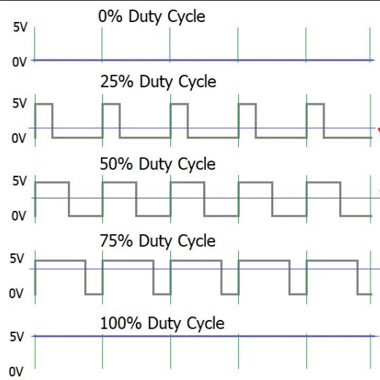
I need 1.75 volt!
Digital output is limited
[ logic '0' = 0 volt, logic '1' = 5 volt] for Arduino Uno.
PWM allows us to get analog voltages from digital output ➔
We used AnalogWrite() for PWM before, now it is time to bare it all (sorry for the puns...)
0v
1.25v
2.5v
3.75v
5v

Slide 3

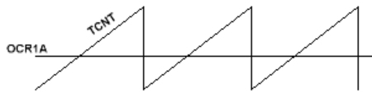
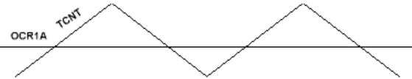




Clock source?
(Frequency)
How to count?
(PWM mode)
Duration?
("Limit")
What happen to output?
(Wave Generation Mode)

Slide 4

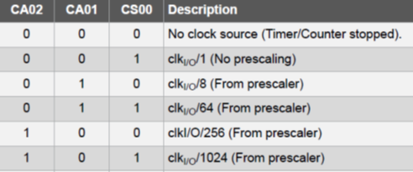
OCRnx (8 bit)
(==) 8-bit Comparator
TCNTn (8 bit)
TIMSKn | 7 | 6 | 5 | 4 | 3 | 2:OCIEB | 1:OCIEA | 0
OC Interrupt
Waveform Generator
OCnx (1 bit)
TCCRnA | CmA1 | CmA0 | CmB1 | CmB0 |  |  | WGM1 | WGM0
TCCRnB |  |  |  |  | WGM2 | CS2 | CS1 | CS0
CMx1 | CMx0 | Behavior
0 | 0 | OC0x disconnected.
0 | 1 | WGM02=0 ➔ OC0x disconnected. WGM02=1 ➔ OC0x toggles.
1 | 0 | OC0x ⬅ 0 (up-count) OC0x ⬅ 1 (down-count)
1 | 1 | OC0x ⬅ 1 (up-count) OC0x ⬅ 0 (down-count)

